Slide 1
SPATIAL DATABASE FINAL PROJECT
By: Jayasurya Duraisamy
Student number: 21250461

Slide 2
Goal
Crime rate of a state determines how safe a state is to live/move in.
In this project, I have analyzed various crimes happened in each state of United States of America and made a ranking with safety score for each state.

Slide 3
Data Collection
Shape file of US:
https://www2.census.gov/geo/tiger/TIGER2017/STATE
Latitude and Longitude data: https://storage.googleapis.com/kagglesdsdata/datasets/772/1440
Crime Data a): https://ucr.fbi.gov/crime-in-the-u.s/2018/crime-in-the-u.s.-2018/tables
Crime Data b): https://ucr.fbi.gov/crime-in-the-u.s/crime-in-the-u.s.-2019
State ranking data: https://www.consumeraffairs.com/homeowners/safest-states-in-the-us.html

Slide 4
Types of crime
Violent crime
Murder and nonnegligent manslaughter
Rape
Robbery
Aggravated assault
Property crime
Burglary
Larceny-theft
Motor vehicle theft

Slide 5
Types of crime
Human trafficking
Commercial sex-acts
Involuntary servitude(Forced Labor)

Slide 6
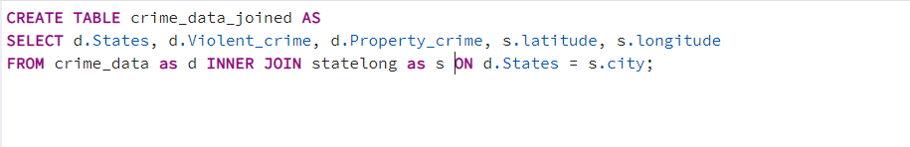
Data Preprocessing
Using inner-join to merge latitude and longitude points with our dataset.
Inner-Join: It combine records from two tables whenever there are matching values in a field common to both tables.
SRID : Spatial reference identifier. It represents spatial data using latitude and longitude coordinates.

Slide 7
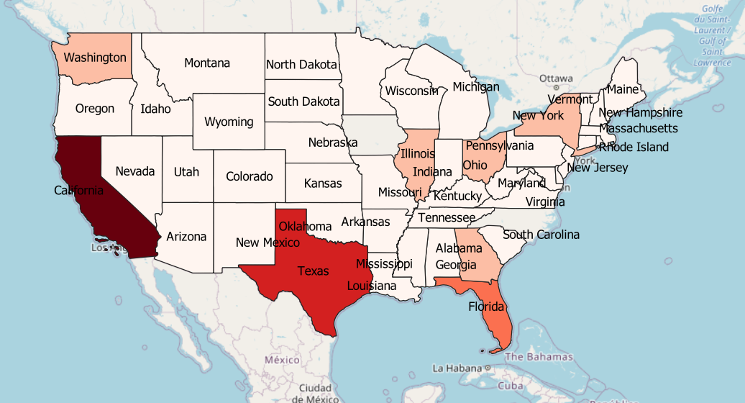
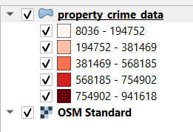
Property Crime
Cities with more crime: California, Texas, Florida

Slide 8
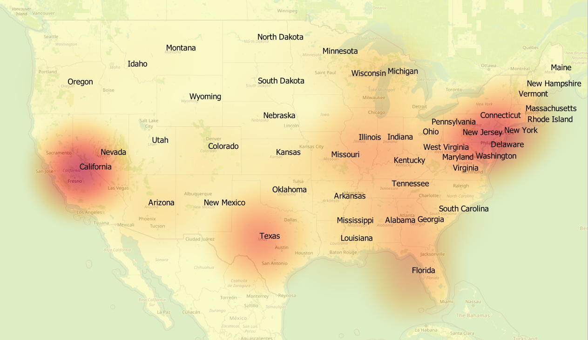
Violent Crime
States with more crime – California, Texas, Florida, New York

Slide 9
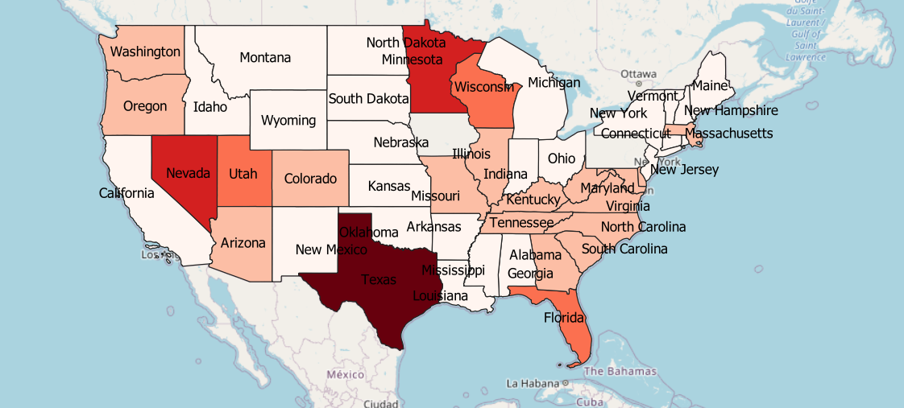
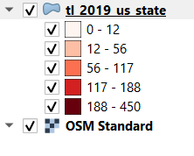
Human Trafficking
States with more crime: Texas, Nevada, Minnesota and Florida

Slide 10
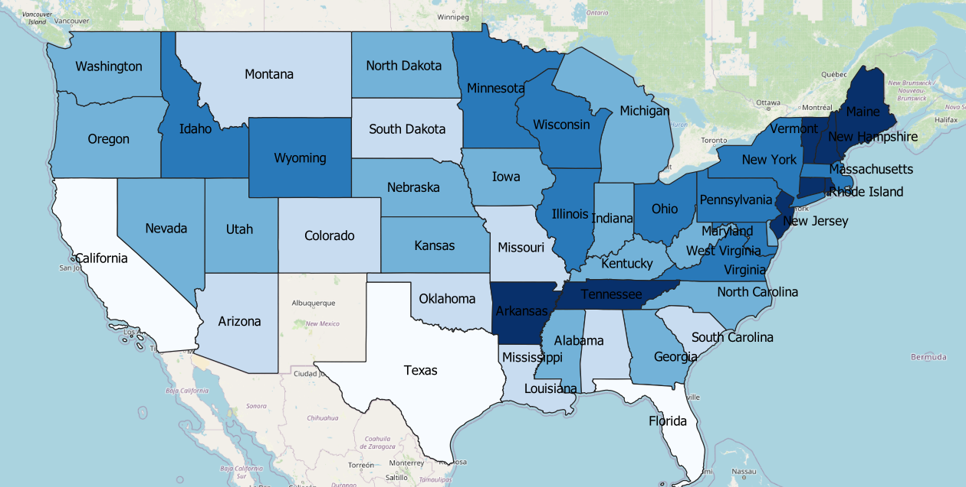
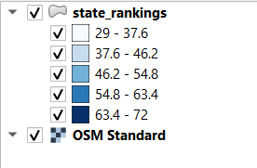
Safest States by rankings
Texas, Florida, California are with low safety scores.
New Jersey, Maine, Rhode Island, Arkansas, Tennessee are with high safety scores

Slide 11
Findings
With the help of Choropleth and Heat maps, we were able to find that most number of crimes(all) happens in Texas, California, Florida.
This also shows that considering the crime rate in these states, these are not the safest states to get settled.

Slide 12
Conclusion
No matter what state you live in, it’s important to take steps to protect yourself, your family and your assets.
Consider installing an alarm system in your home and make sure you have the right types and amounts of homeowners insurance and auto insurance in case you’re the victim of a property crime.
If you’re choosing a new place to live and want to know more about crime in certain areas — or if you’re curious about trends in your own state or town — you can find data about specific crimes and cities from the FBI. You might also try getting information from your local municipality, which is likely to have the most recent information.

